Slide 1

Dissipative Deep Neural Dynamical Systems
Third Symposium on Machine Learning
and Dynamical Systems
Fields Institute, Toronto, Canada
9/28/2022
Jan Drgona
Collaborators: Aaron Tuor, Soumya Vasisht,
Mia Skomski, Draguna Vrabie

Slide 2

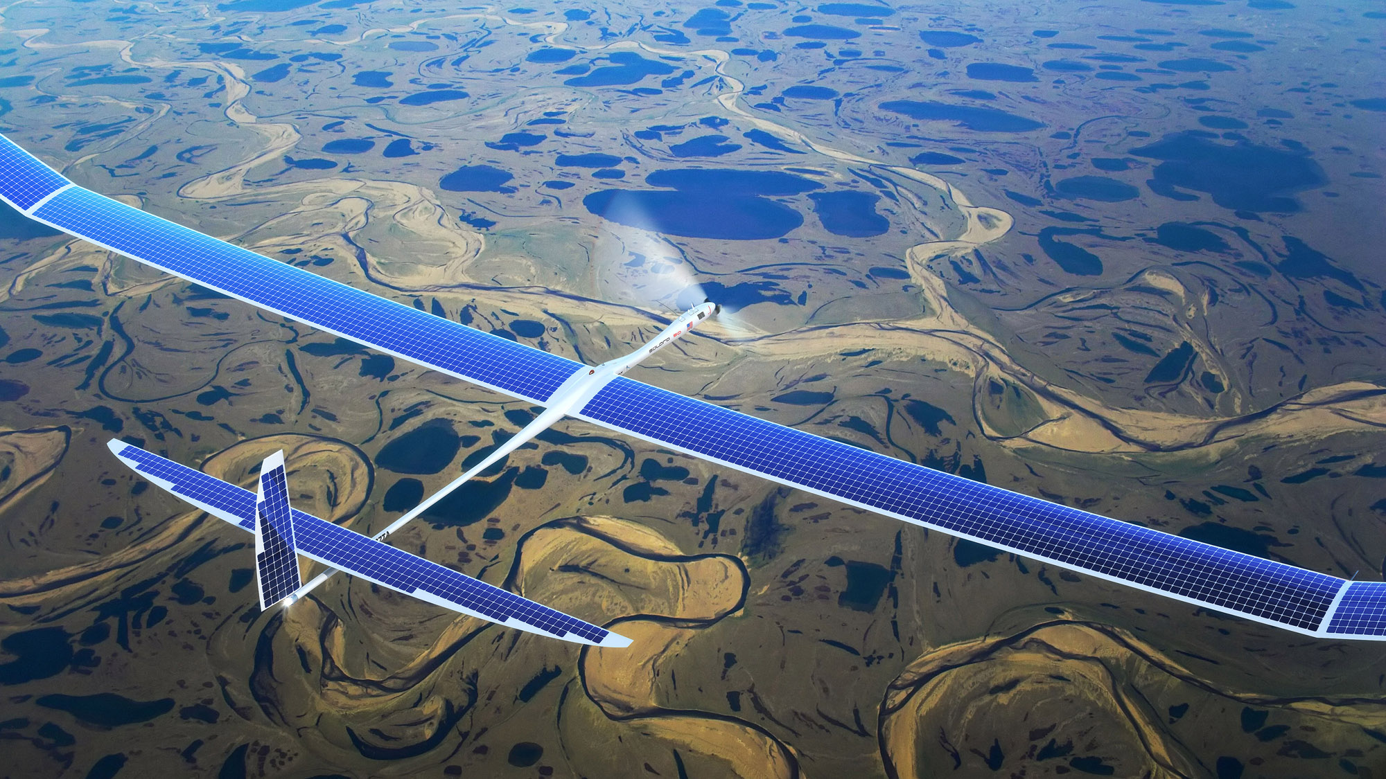
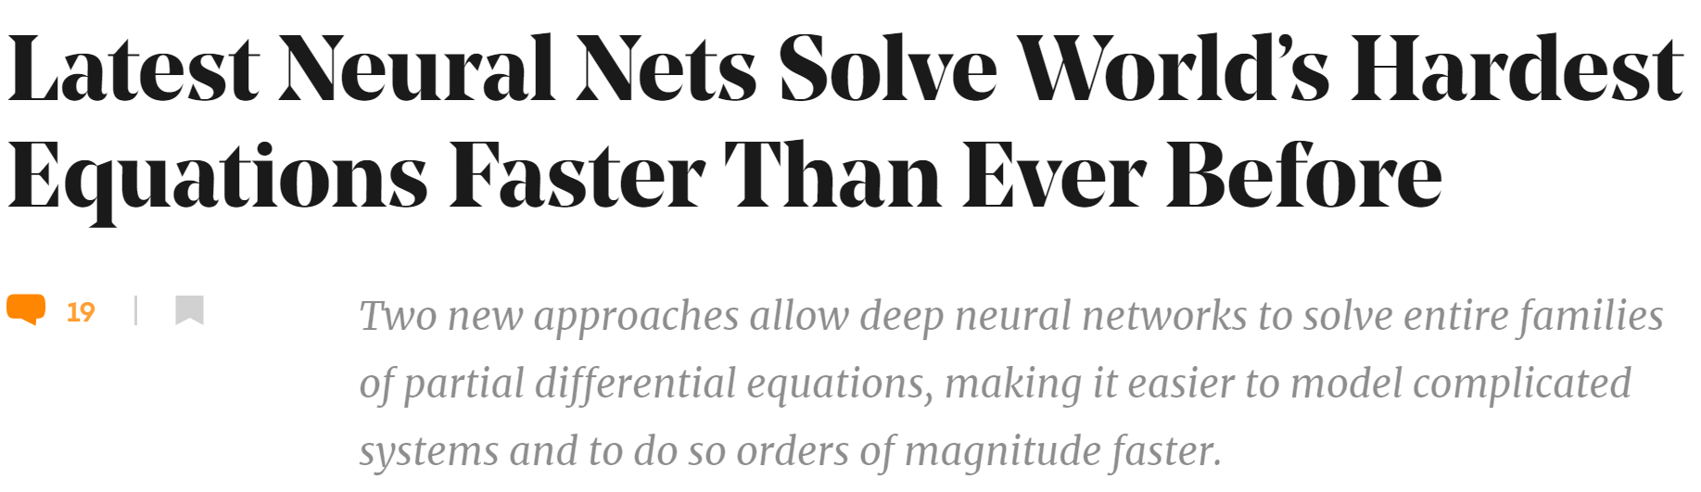

Motivation
Simulations are crucial for many areas of decision-making and scientific discovery
Need: Improve computational efficiency and scalability for heterogenous scientific simulations
Methods: Integration of machine learning with physics-based models
Applications: Optimization, modeling and control of dynamical systems
Challenges: Analysis, interpretability, rigorous performance and safety guarantees

Slide 3
Stability of Deep Neural Networks
Spectral approaches
Eldad Haber and Lars Ruthotto, Stable Architectures for Deep Neural Networks, IOP, 2017
S. Wang et al., “Analysis of deep neural networks with extended data Jacobian matrix”, ICML, 2016
Z. Liao and R. Couillet, “The dynamics of learning: A random matrix approach”, ICML, 2018
Contraction and Lipschitz approaches
M. Fazlyab, et al., “Efficient and accurate estimation of Lipschitz constants for deep neural networks”, NeurIPS, 2019,
M. Revay and I. R. Manchester, “Contracting implicit recurrent neural networks: Stable models with improved trainability”, L4DC, 2020
P. Pauli, et al., “Training robust neural networks using Lipschitz bounds”, IEEE Con. Sys. Lett., 2022
Lyapunov and Potential function approaches
G. Manek and J. Z. Kolter, “Learning stable deep dynamics models”, NeurIPS, 2019
Spencer M. Richards, Felix Berkenkamp, Andreas Krause, “The Lyapunov Neural Network: Adaptive Stability Certification for Safe Learning of Dynamical Systems”, CoRL 2018
A. Sosanya and S. Greydanus, “Dissipative Hamiltonian neural networks: Learning dissipative and conservative dynamics separately”, CoRR, vol. abs/2201.10085, 2022.

Slide 4
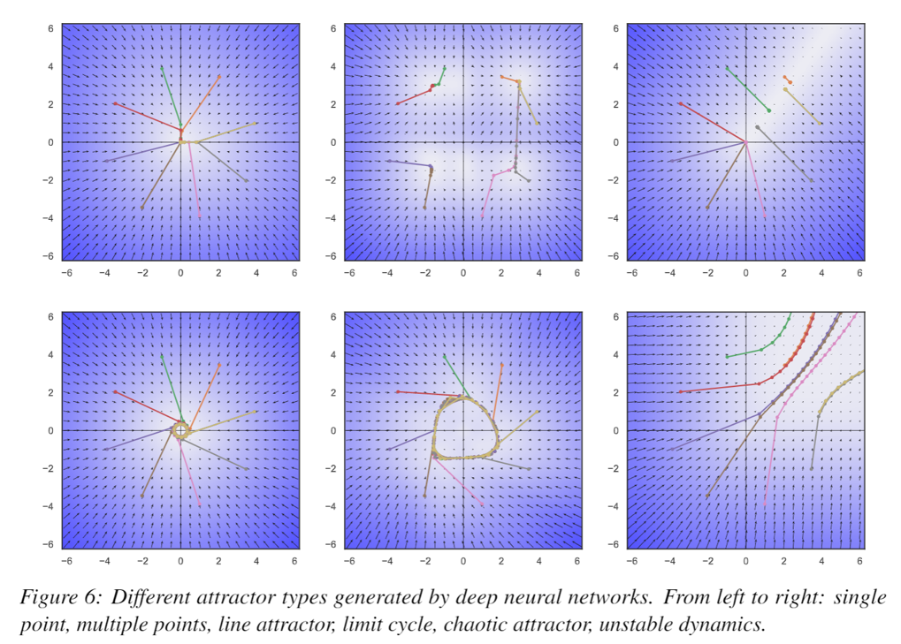
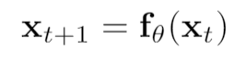
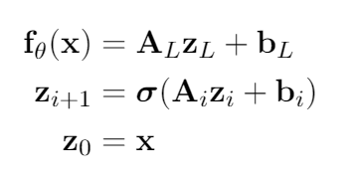
Deep Neural Dynamical System
Explore connections between:
Deep neural network components
Piecewise affine (PWA) maps
Contraction of PWA maps
Dissipativity of dynamical systems
2D attractors generated by deep neural dynamics.

Slide 5
Deep Neural Dynamical System
Explore connections between:
Deep neural network components
Piecewise affine (PWA) maps
Contraction of PWA maps
Dissipativity of dynamical systems
2D attractors generated by deep neural dynamics.

Slide 6
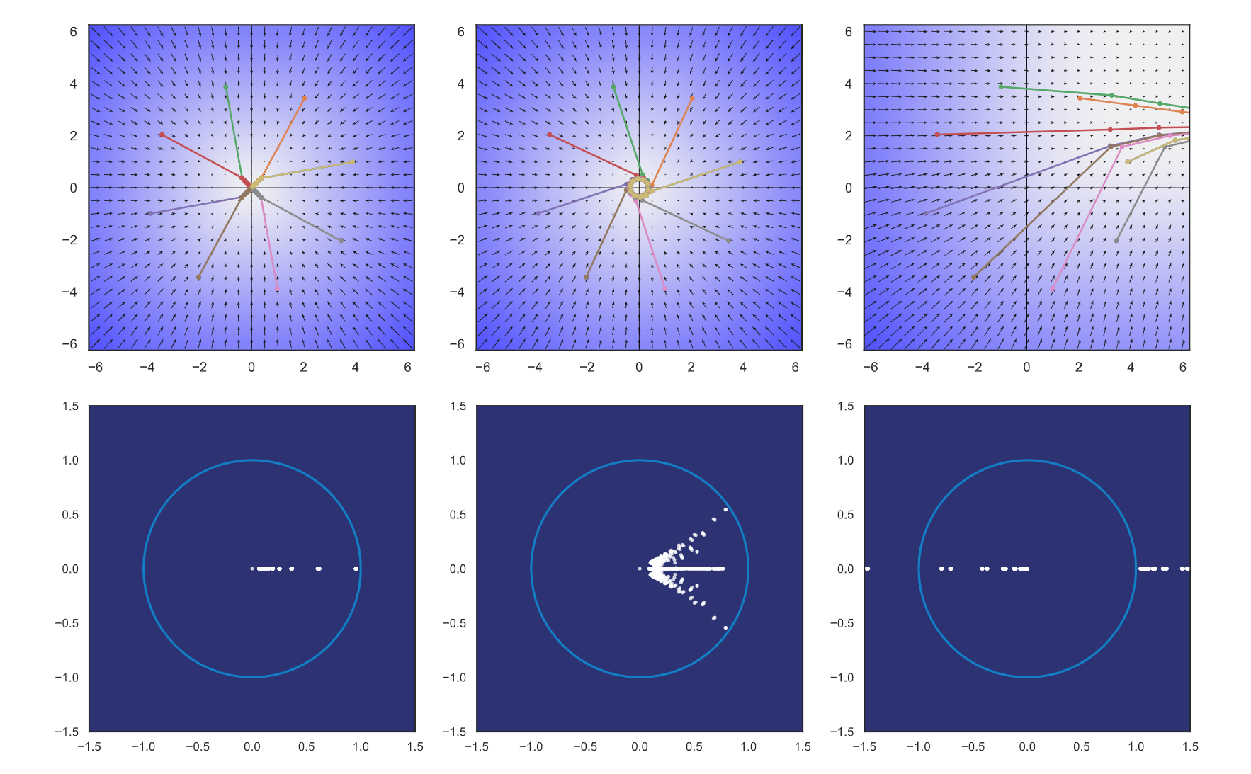
Dynamical Effects of Weights
Intuition: weight eigenvalues determine stability of DNN.
Weight eigenvectors determine eigenvector basis of DNN.
J. Drgoňa, A. Tuor, S. Vasisht and D. Vrabie, "Dissipative Deep Neural Dynamical Systems," in IEEE Open Journal of Control Systems, vol. 1, pp. 100-112, 2022
Notes:
Roughly: eigenvalues of weights primarily determine stability of DNN

Slide 7
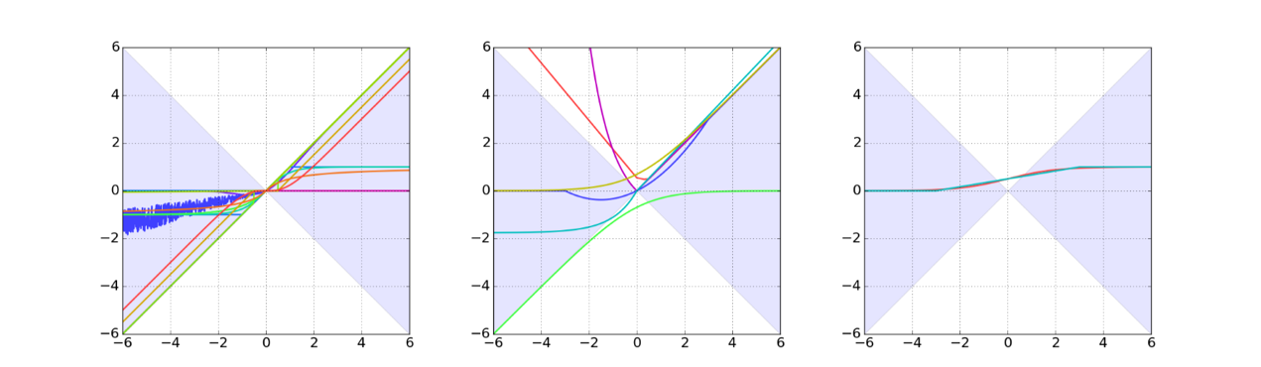
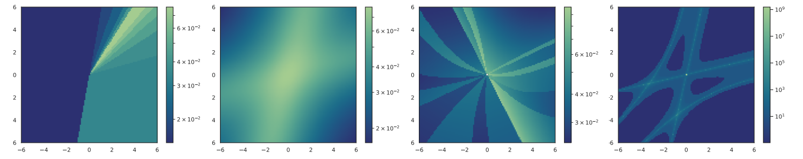
Dynamical Effects of Activation Functions
Most commonly used activation functions such as ReLU, GELU, or tanh are contractive.
Intuition: Activation functions determine state space partitioning and scaling of local eigenvalues.
J. Drgoňa, A. Tuor, S. Vasisht and D. Vrabie, "Dissipative Deep Neural Dynamical Systems," in IEEE Open Journal of Control Systems, vol. 1, pp. 100-112, 2022

Slide 8
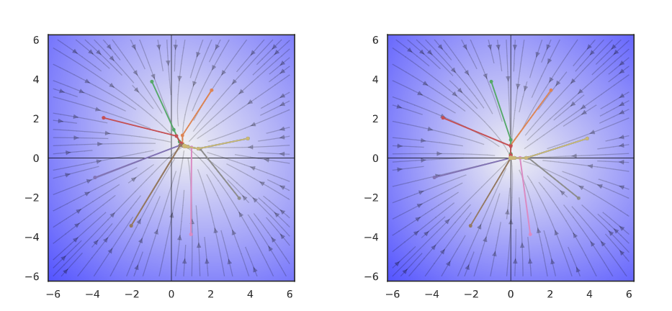
Dynamical Effects of Biases
Intuition: biases determine state space partitioning and the location of region of attraction via coordinate shifts.
Zero bias with stable weights leads to steady state at the origin.
Non-zero biases define fixed points of deep neural dynamics with stable weights.
J. Drgoňa, A. Tuor, S. Vasisht and D. Vrabie, "Dissipative Deep Neural Dynamical Systems," in IEEE Open Journal of Control Systems, vol. 1, pp. 100-112, 2022
Notes:
Roughly: bias primarily determines steady sates or location of region of attraction

Slide 9
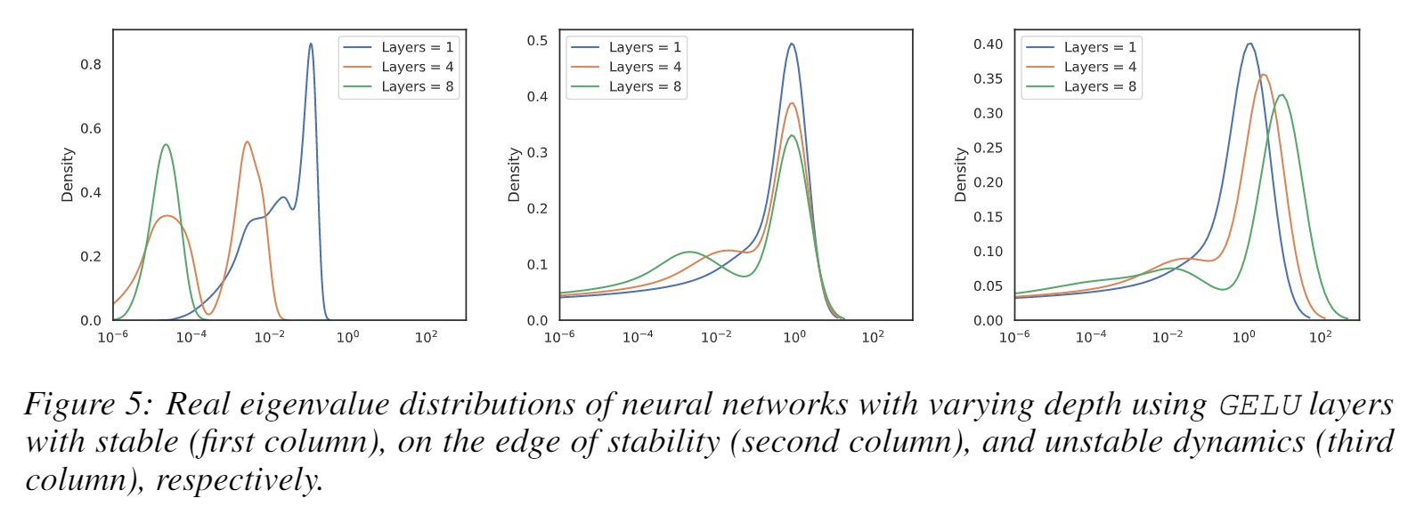
Dynamical Effects of Network Depth
Deeper networks shift their eigenvalue distribution towards heavy tail distributions and exacerbate the dynamical effects of their layers leading to vanishing and exploding gradient problem.
J. Drgoňa, A. Tuor, S. Vasisht and D. Vrabie, "Dissipative Deep Neural Dynamical Systems," in IEEE Open Journal of Control Systems, vol. 1, pp. 100-112, 2022

Slide 10
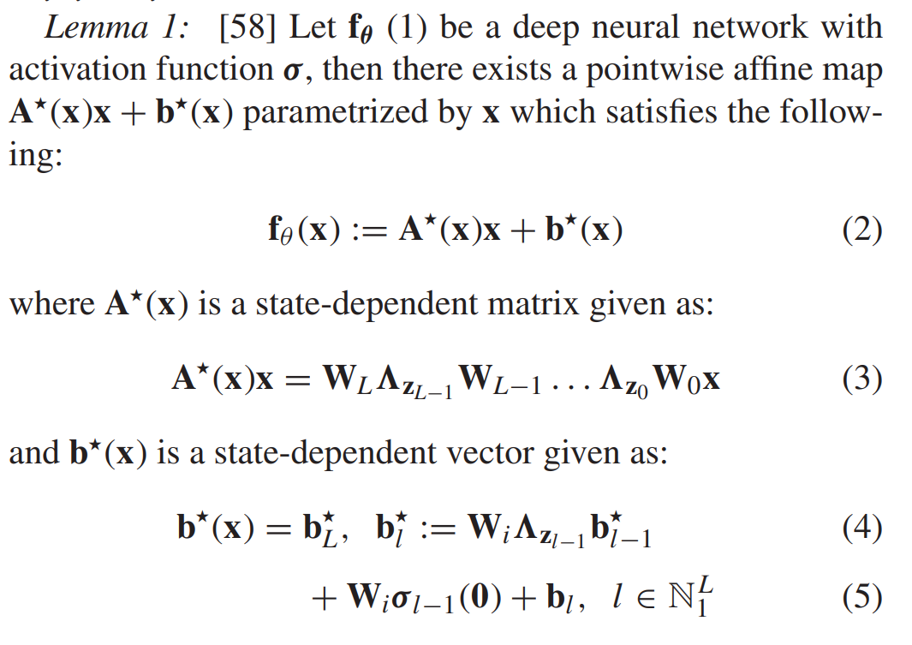
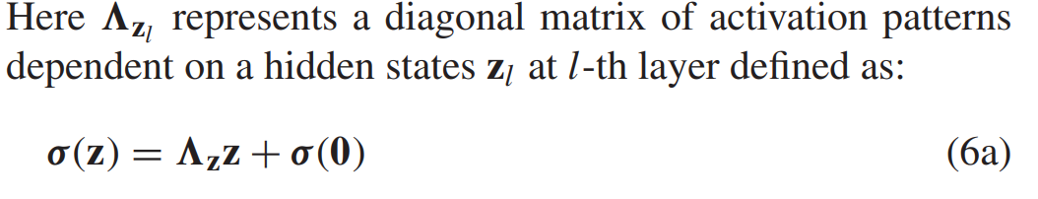
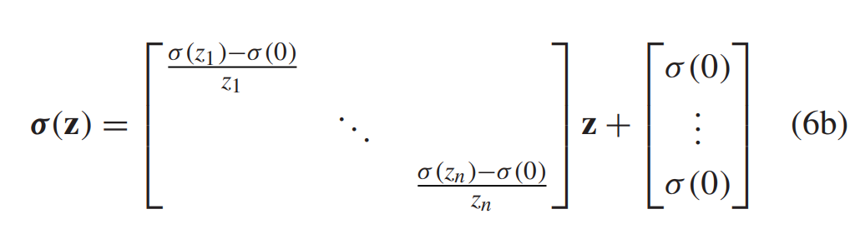
Deep Neural Networks as Piecewise Affine Maps
Refactoring neural networks to expose their local affine operators suitable for analysis.
J. Drgona, S. Mukherjee, J. Zhang, F. Liu, and M. Halappanavar, “On the stochastic stability of deep Markov models,” in Proc. Adv. Neural Inf. Process. Syst. (NeurIPS), 2021.

Slide 11
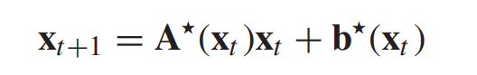
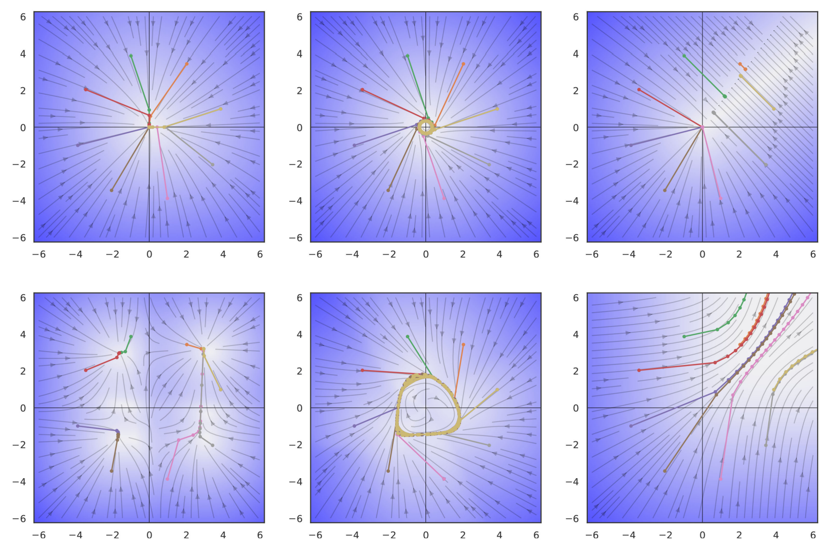
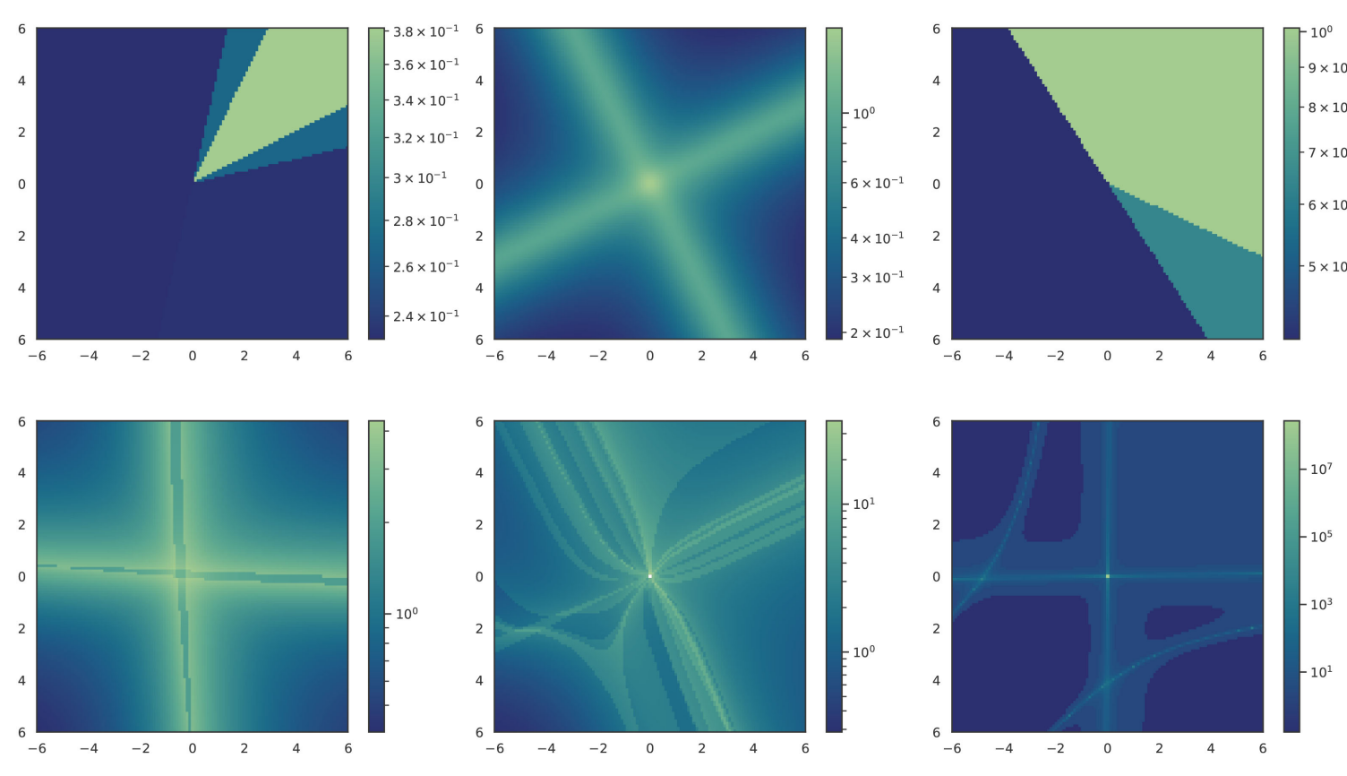
Analysis of Local Operators of Autonomous Neural Dynamics
2D attractors generated by deep neural dynamics.
State space partitioning.
J. Drgoňa, A. Tuor, S. Vasisht and D. Vrabie, "Dissipative Deep Neural Dynamical Systems," in IEEE Open Journal of Control Systems, vol. 1, pp. 100-112, 2022

Slide 12
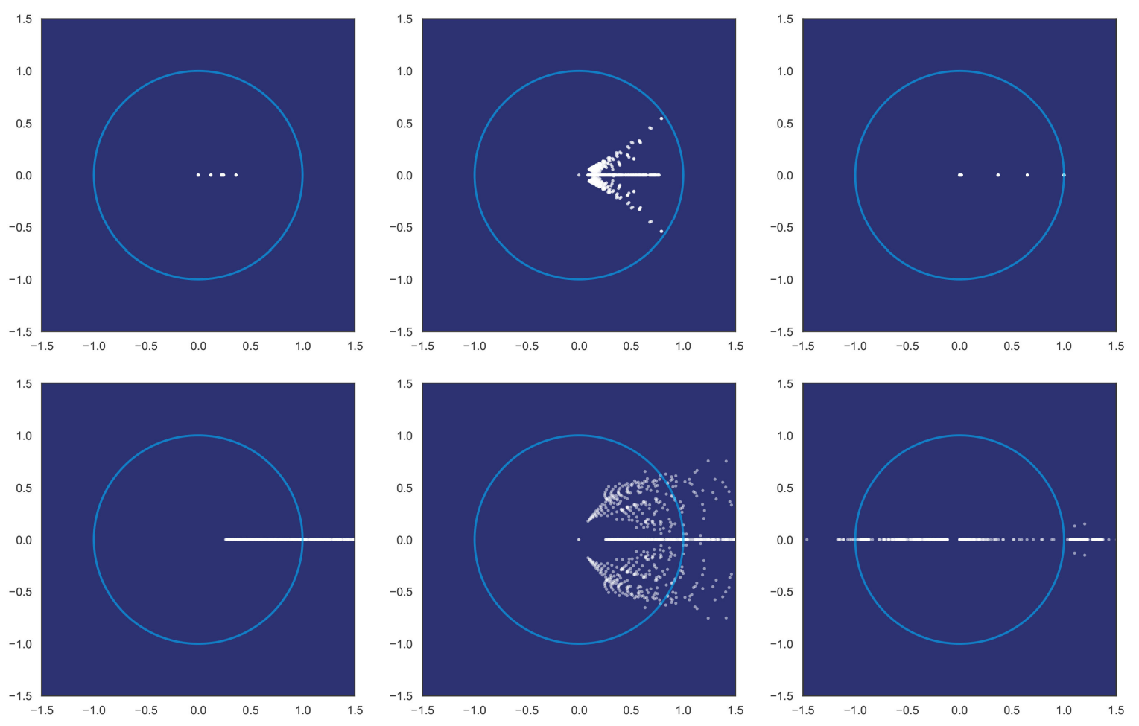
Analysis of Local Operators of Autonomous Neural Dynamics
2D attractors generated by deep neural dynamics.
Eigenvalue distributions.
J. Drgoňa, A. Tuor, S. Vasisht and D. Vrabie, "Dissipative Deep Neural Dynamical Systems," in IEEE Open Journal of Control Systems, vol. 1, pp. 100-112, 2022

Slide 13
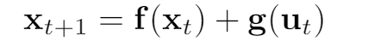
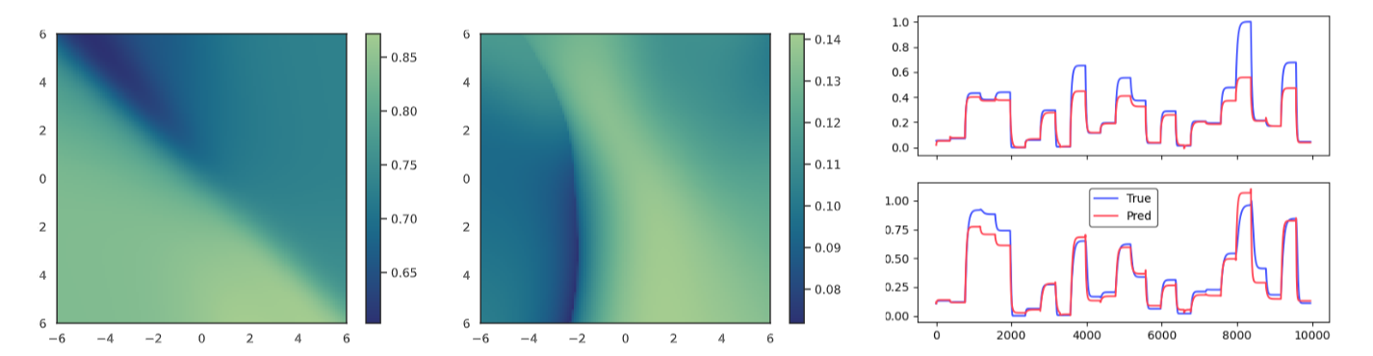
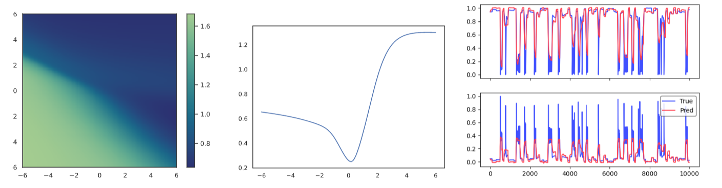
Analysis of Local Operators of Non-autonomous Neural Dynamics
Two tank system: 2 states x, 2 inputs u
Exothermic stirred tank reactor system: 2 states x, 1 input u
J. Drgoňa, A. Tuor, S. Vasisht and D. Vrabie, "Dissipative Deep Neural Dynamical Systems," in IEEE Open Journal of Control Systems, vol. 1, pp. 100-112, 2022

Slide 14
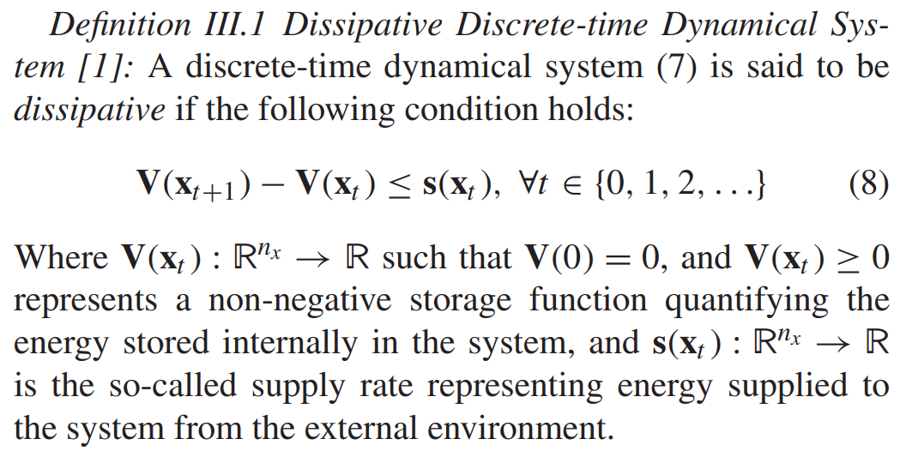
Dissipativity of Dynamical Systems
Dissipativity is an extension of Lyapunov stability for open systems.
C. Byrnes and W. Lin, “Losslessness, feedback equivalence, and the global stabilization of discrete-time nonlinear systems,” IEEE Trans. Autom. Control, vol. 39, no. 1, pp. 83–98, Jan. 1994.

Slide 15
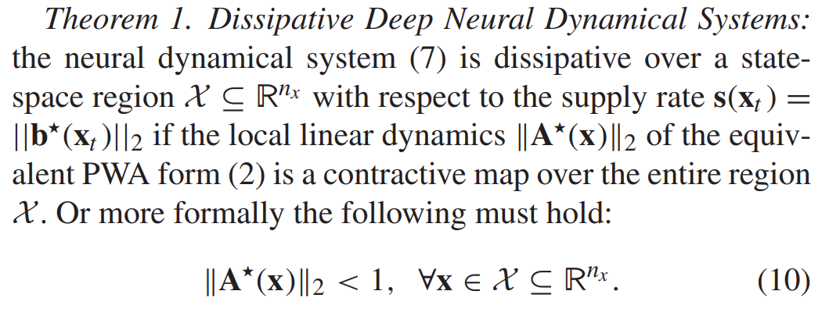
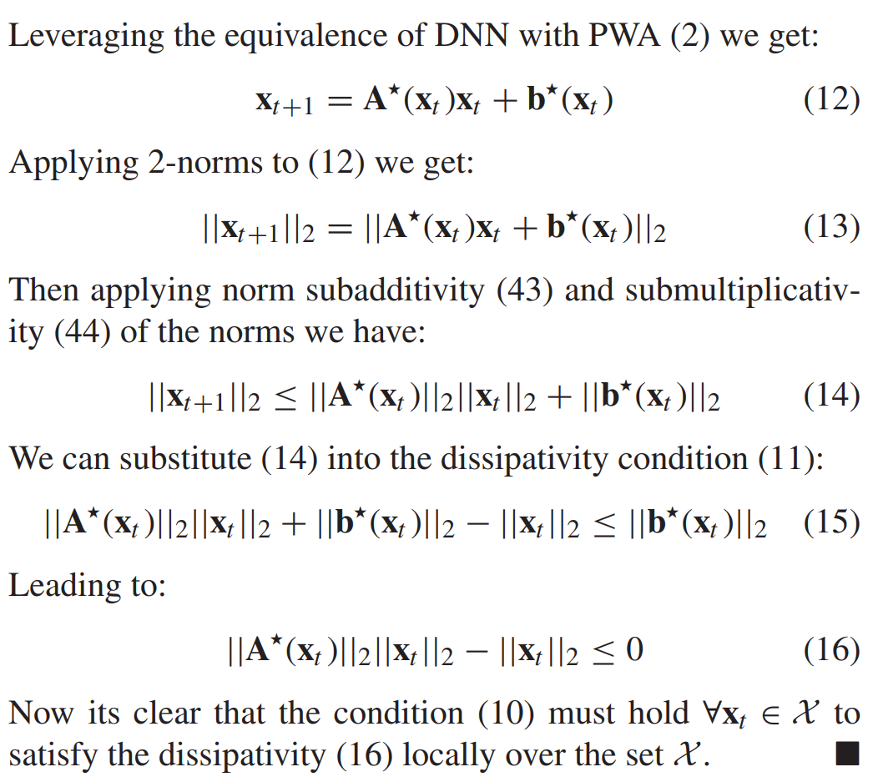
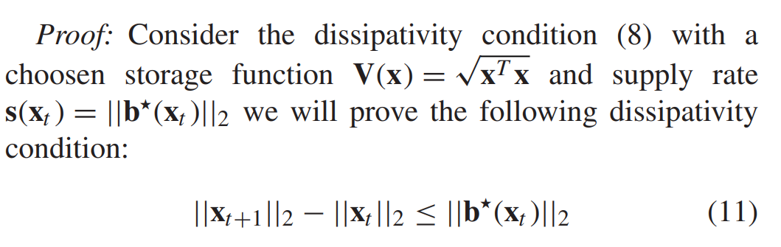
Dissipative Deep Neural Dynamical System
J. Drgoňa, A. Tuor, S. Vasisht and D. Vrabie, "Dissipative Deep Neural Dynamical Systems," in IEEE Open Journal of Control Systems, vol. 1, pp. 100-112, 2022

Slide 16
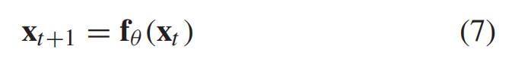
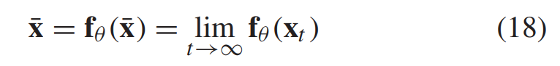
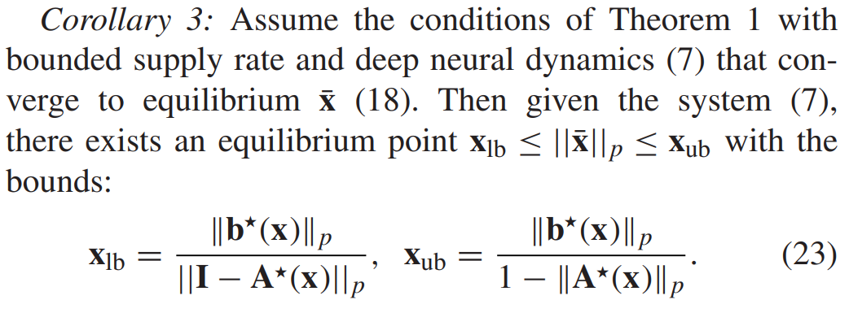
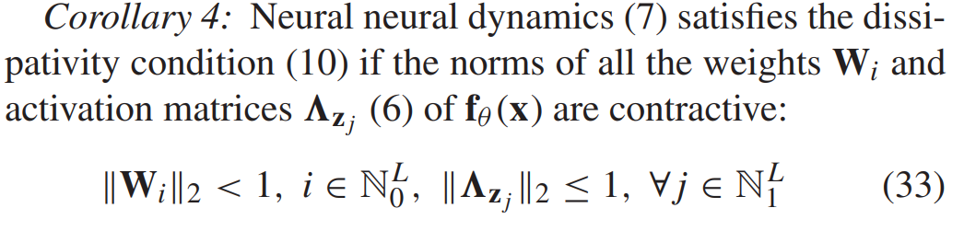
Steady States of Deep Neural Dynamics
Intuition: for stable systems, region of attraction shrinks with smaller bias terms and stronger contractivity of neural network layers and vice versa.
Intuition: submultiplicativity of layer norms allows to design globally dissipative neural dynamics by choosing the weights and activation functions.
J. Drgoňa, A. Tuor, S. Vasisht and D. Vrabie, "Dissipative Deep Neural Dynamical Systems," in IEEE Open Journal of Control Systems, vol. 1, pp. 100-112, 2022

Slide 17
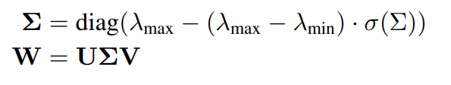
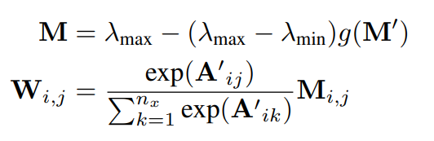
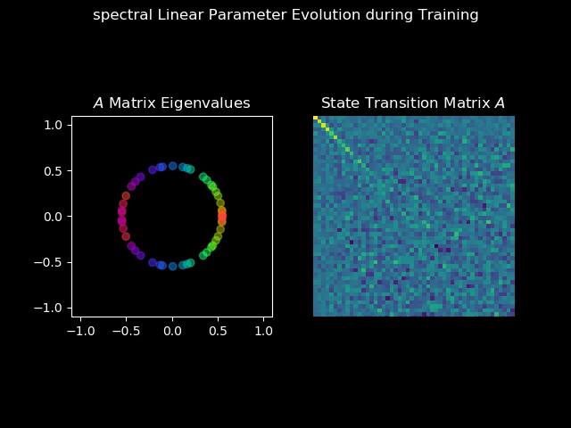
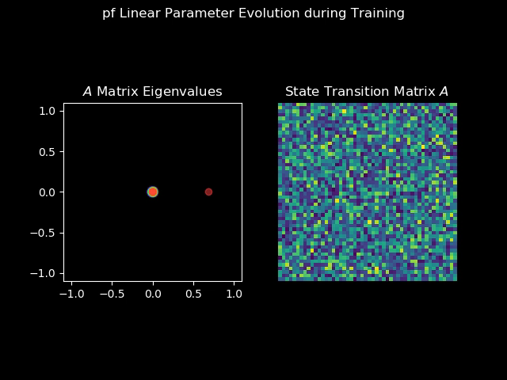
Practical Eigenvalue Constraints for Weights
SVD factorization
Perron-Frobenius map
Pytorch implementation: https://github.com/pnnl/slim
[1] J. Drgoňa, A. Tuor, S. Vasisht and D. Vrabie, "Dissipative Deep Neural Dynamical Systems," in IEEE Open Journal of Control Systems, vol. 1, pp. 100-112, 2022
[2] Jiong Zhang, et al., Stabilizing Gradients for Deep Neural Networks via Efficient SVD Parameterization, 2018.

Slide 18
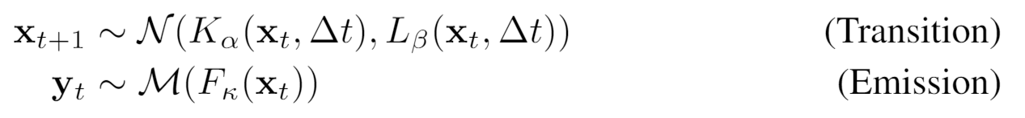
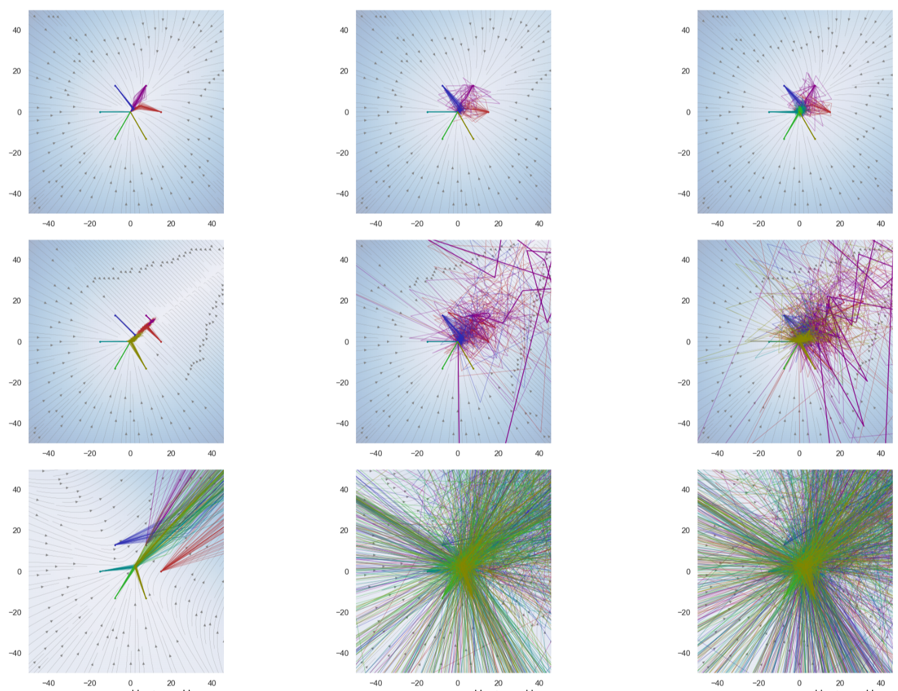
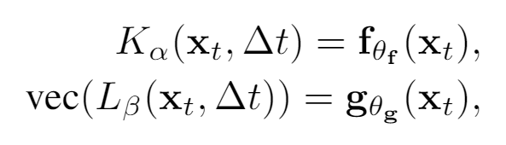
Extension: Stability of Deep Markov Models
Exploring connections between:
Stability of stochastic systems
Deep neural networks (DNNs)
Deep Markov models (DMMs)
Contraction of DMMs
2D attractors generated by deep Markov models.
Jan Drgona, et al., On the stochastic stability of deep Markov models, NeurIPS 2021.

Slide 19
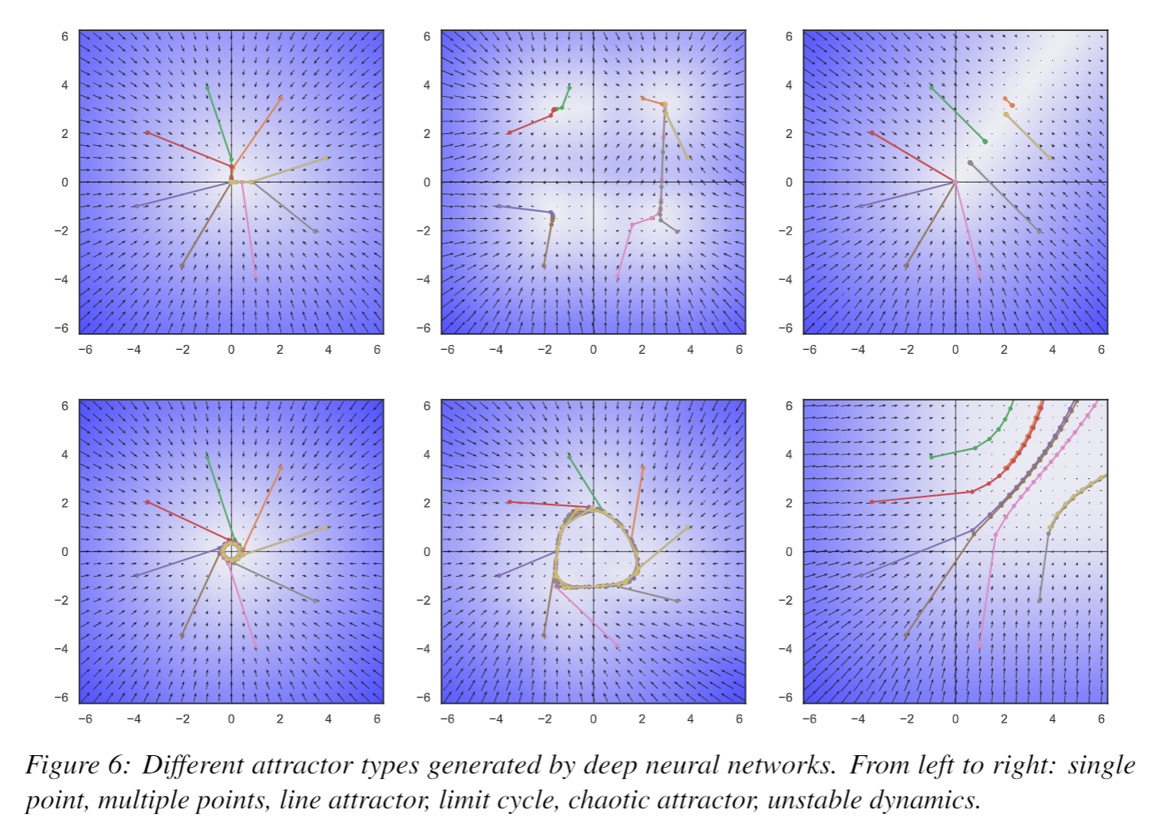

Conclusion
Dissipativity of Deep Neural Networks
Deep neural networks (DNNs)
Piecewise affine (PWA) maps
Dissipativity of PWA
Weight Constraints
Structured linear maps (SLIM) in Pytorch
https://pnnl.github.io/slim/
Contact
jan.drgona@pnnl.gov
https://www.linkedin.com/in/drgona/

Slide 20
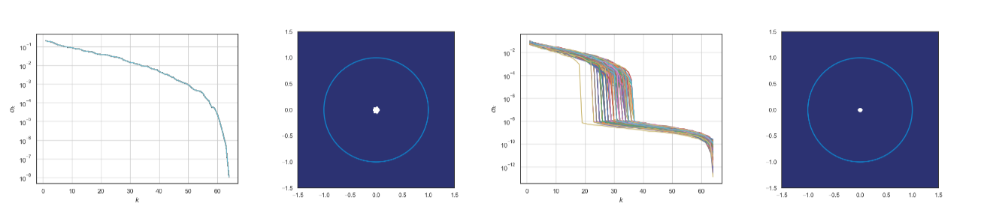
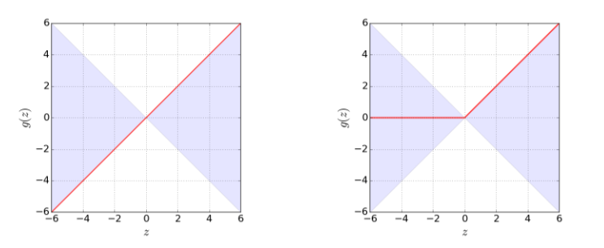
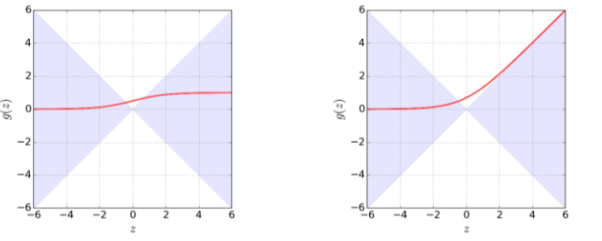
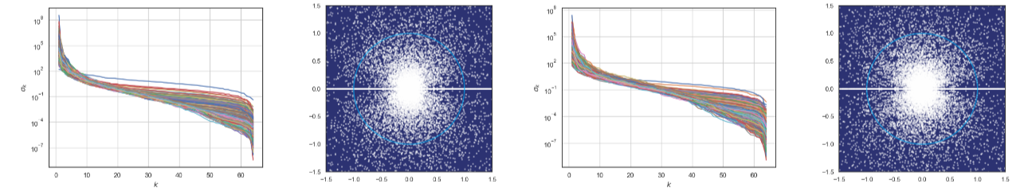
Nonlinearity and Eigenvalues of Deep Neural Networks with Different Activation Functions
Identity
ReLU
Sigmoid
SoftExponential
Intuition: Activation functions shape eigenvalue distributions of deep neural networks.
J. Drgoňa, A. Tuor, S. Vasisht and D. Vrabie, "Dissipative Deep Neural Dynamical Systems," in IEEE Open Journal of Control Systems, vol. 1, pp. 100-112, 2022

Slide 21
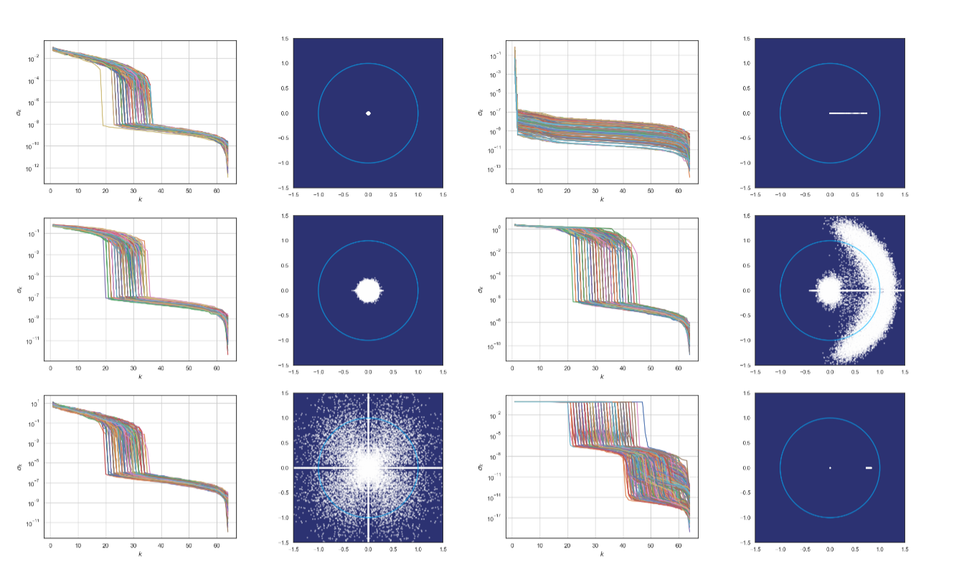
Spectra of Deep Neural Network with Different Weight Factorizations
Notes:
Non-regularized, perron-frobenius, spectral, sew-symmetric, Hamiltonian, gershorin

